Slide 1
Solution Architecture Canvas
Chicago DMC

Slide 2
Solution Architecture Canvas
Vision/Business Objectives:
Key Business Scenarios (MVP): A B |  |  | Data Integrations & Data Sources: Data Sources used, Systems integrated with for retrieving/updating data Identify any data sources/needs that would be impacted by GDPR
Key Capabilities Impacted A B | Conceptual View of Target State |  |  |  | Key Architecture Drivers / Quality Attributes These are the quality attributes/non-functional req’ts of the solution. See Slide 8 These are specific to the project. Describe below or on another slide which attributes your project will implement and how it will do so.
Risks A B |  | Assumptions A B | Risks A B | Decisions A B
Notes:
Single page model for representing the architecture of an solution and implementation considerations. Can also be used as a tool for collaborating with stakeholders on architecture

Slide 3
Appendix
Refer to these slides to help you assess the proposed architecture for your solution.

Slide 4
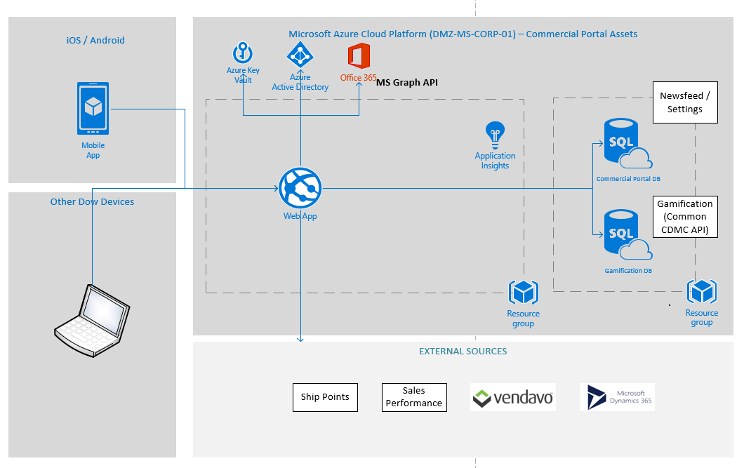
Architecture Canvas
Example
Vision/Business Objectives: Allow sellers a mobile hub where they can see key performance indicators, link out to commonly used applications and capabilities, and store their preferences. This will improve pre-call planning time and quality, customer service, improve (seller) self-service, reduce email, and help drive adoption of other sales enablement tools, ultimately improving seller performance
EA Vision: Support business vision for mobile access to information sellers need for their job, and provide sellers a hub for their performance indicators and applications. |  | Key Architecture Guidelines: DevOps - Architect for continuous delivery Cloud-First/Cloud-Native/Microservices
Key Business Scenarios (MVP) Business communication hub Report of Call performance indicators Opportunity performance indicators Pricing performance indicators Ship points and lead times off network lookup Account sales performance indicators Personal sales performance indicators | Conceptual View of Target State (Click out for more details – image is link) |  |  | Key Architecture Drivers / Quality Attributes* These are the quality attributes/non-functional req’ts of the solution. Need for stable, secure, reliable and robust system Need to achieve high modifiability, aim for good modularity, which means high cohesion and low coupling. Extensibility / Adaptability Need to achieve security, limit the points of access to critical resources.
Key capabilities impacted N/A – this app is an add / a hub for info and linking out to other apps. |  | Risks Many different systems and authentication methods Many different stakeholders and technical teams Different visions for what a seller can and should do where Design not fixed and need lead time to get external team collaboration New patterns | Assumptions NAA Industrial Solutions Sellers only Limited data and KPI from external data, link out to see more detail No writing to external sources, read only
 |  |  | Decisions Azure hosted Mobile apps deployed through Intune Angular / Cordova / Ionic for build Azure AD App Roles for RBS No HA architecture No Offline capability
Notes:
Single page model for representing the architecture of an solution and implementation considerations. Can also be used as a tool for collaborating with stakeholders on architecture.

Slide 5
Key Architecture Drivers / Quality Attributes
Example
-Need to achieve high modifiability, aim for good modularity, which means high cohesion and low coupling.
System will have discrete microservices/APIs. Tiles reaches out to different data sources, and any service being unavailable will not affect system. Tiles can also be implemented / upgraded / retired independently without affecting the rest of the system.
-Need to achieve security, limit the points of access to critical resources.
Azure EZ Auth for authentication to external systems and services
Azure AD for application access and authentication
Azure Application roles for role based security
Azure Keyvault for app settings and functional account storage
-Need for extensible data architecture
System to expand to additional user roles and businesses. Will have business specific settings, user groups, and ability to have business specific tiles
Should allow for swapping sources in the future (especially as O365 becomes more prevalent)
-Interoperability
Authentication to multiple different systems of record and engagement
Portability (iOS, Android, all web browsers, tablet)
Angular, Cordova, Ionic for one code base that can work natively on different devices.

Slide 6
Architecture Canvas
Architecture Canvas is a single page representation of architecture depicting the key elements that capture the architecture of a solution, thereby functioning as a conversation starter. It enables key stakeholders from diverse backgrounds, such as product owners, devops engineers, architects, and developers to come together and discuss and collaborate on architecture from a simple, single page visual.
It has eight sections.
The vision and business objective section is used to introduce the business context. It specifies the business vision and the key business objectives that the architecture will realize.
The Data Integrations section briefly describes the systems and data sources the solution will access.
The key business scenarios indicate the key problem frames and the scenarios that the architecture is solving for, typically described using up to three high level user stories. The solution should identify the Mean Viable Product features that need to be delivered.
Conceptual view of target state is a quick sketch describing architecturally significant components and their interaction that enables the target state solution.
Key drivers and architecture attributes indicates what are the key forces that are shaping the architecture, and therefore the quality attributes that need to be built into the architecture.
It is also helpful to include a separate slide (if necessary) to explain how the solution will address the NFRs
Key capabilities impacted provides a high-level snapshot of impacted capabilities. This is typically categorized as business applications, services, information stores, technology infrastructure, etc., and it can also indicate which of the components are new to the architecture, which are being modified, and which are being made redundant and being removed.
Key assumptions, risks, and decisions list the set of key assumptions and risks taken into account while working on the architecture, and also some architecturally significant decisions made in the process.

Slide 7
Context: High level Architectural Approach
Business Goals
TCO
…
NFRs
Availability
Maintainability
Architectural Tactics
Design Patterns
Anti Patterns
Quality
Market Share
Customer Experience
Elasticity
Security
Extensibility
Performance
Usability
Interoperability
Portability
Stateless Design
Microservices
Caching
Claim based authentication
Publish-Subscribe
Asynchronous Communication
Notes:
This slide provides some context in how a business goal aligns to an NFR and to an architectural/implementation tactic

Slide 8
PaaS applications, NFRs, and the architect's role
Non-functional requirements should actually be considered in terms of the qualities you want from your solution as well as the constraints you will be operating under.
Cloud Platform as a Service (PaaS) environments take this paradigm a step further by removing horizontal scaling, placement of components, logging, and system management from the architect's purview. These operations happen, but as an IT architect you have no control (or almost no control) over them
Availability - How long the system is up and running and the Mean Time Between Failure (MTBF) is known as the availability of a program. How long does the system need to run without failure? What is the acceptable length of time for the system to be down? Can down times be scheduled?
Elasticity (Scalability) - Scalability is the ability for your program to gracefully meet the demand of stress caused by increased usage. In short, ensuring your program doesn’t slow or bust when pounded by more users than you originally anticipated.
Security - the measure of system’s ability to resist unauthorized attempts at usage or behavior modification, while still providing service to legitimate users. Does the system need user or role based security? Does code access security need to occur? What operations need to be secured? How will users be administered?
Extensibility (Adaptability) – How easy is it to extend, add to or grow services as business needs change? For example if I want to change my business processes or connect to new back end or external API’s how easy would it be to do that?
Performance – How well suited is the solution infrastructure to supporting the workloads that will be deployed onto it, particularly as workloads grow?
Usability – This will be different depending on who the client is (i.e. business users, developers/architects or IT operations). In all cases however you need to consider ease of use of the software and how well designed interfaces are etc.
Maintainability implies how brittle the code is to change. As a result, we tie the terms flexibility and testability into the overall maintainability of a project. Does the entire team understand the code base or does knowledge islands exist? Is the code thoroughly regression tested? Can modifications to the project be done in a timely manner?
Interoperability (Integration) – In a world of hybrid cloud where some workloads and data need to remain in your own data center (usually systems of record) while others need to be deployed in public or private clouds (usually systems of engagement) how those two clouds integrate is crucial.
Portability - Portability is the ability for your application to run on numerous platforms. This is can include actual application hosting, viewing, or data portability. Can the data be migrated to other systems? For web applications, which browsers does your web app support? Which operating systems does your program run on?
Notes:
non-functional requirements should actually be considered in terms of the qualities you want from your IT system as well as the constraints you will be operating under.
Cloud Platform as a Service (PaaS) environments take this paradigm a step further by removing horizontal scaling, placement of components, logging, and system management from the architect's purview. These operations happen, but as an IT architect you have no control (or almost no control) over them

Slide 9
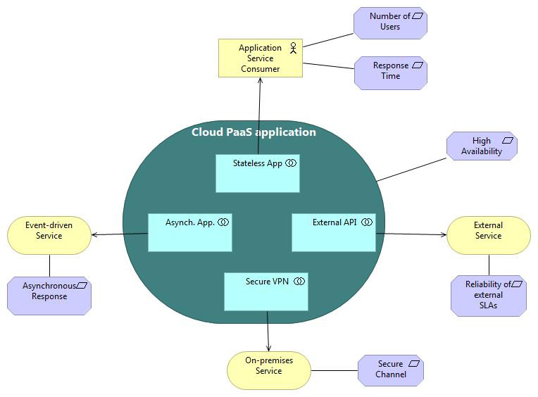
Cloud/Digital NFR-Management Actors
If you draw the operational context diagram of a PaaS application, you can identify four types of external actors and the necessary NFRs
Users of the application itself (consumers of the application services): These actors usually have requirements relating to the application's response time and availability. In addition, a typical cloud application often has unpredictable loads due to the varying number of concurrent users.
External systems: These are physical systems external to the cloud that are not under the application architect's control.
Event-driven services: Some services might implement long-running processes or an asynchronous interface.
On-premises systems (hybrid services): Both the cloud components and on-premises components of an on-premises system are under the control of the application architect, who can therefore tune them according to NFRs.
Notes:
This slide provides a framework to help you identify the actors of the solution and the potential NFRs

Slide 10
Architectural Tactics - Cloud Design Patterns
Cloud computing benefits are realized by implementing a solution with elastic scalability, metered consumption and automation, not by simply using IaaS or PaaS.
IT architects must adopt cloud-native principles and design patterns such as microservices and understand the impact of design decisions.
NFR management by the architect doesn't disappear in cloud environments. Instead, it moves to the applications' inner mechanisms and translates into a number of application design patterns.

Slide 11
PaaS NFR-Management Design Patterns (example)
Corresponding to the four PaaS actors, we have identified four NFR-related design patterns:
A Stateless App pattern to manage scaling of the number of users, high availability, and support for short response times even when the system is loaded.
An Asynchronous App pattern to manage response time and continuous availability when long-running services are required to participate in the application process.
An External API pattern to manage high availability and scaling when the flow of the process involves external systems.
A Secure VPN pattern to securely integrate on-premises systems.

Slide 12
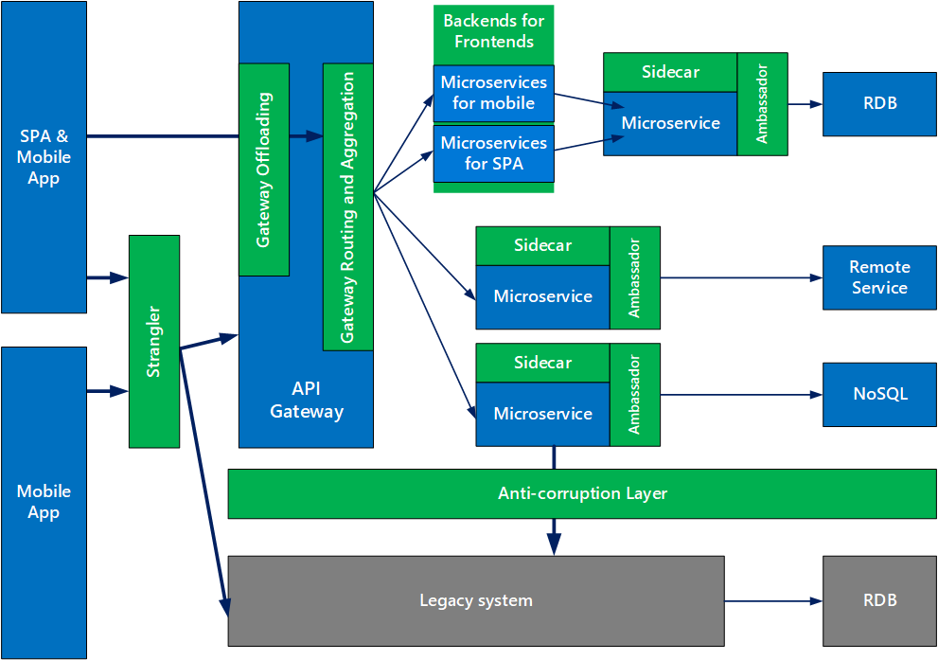
Design Patterns for Microservices – example
The goal of microservices is to increase the velocity of application releases, by decomposing the application into small autonomous services that can be deployed independently.
A microservices architecture also brings some challenges, and these patterns can help mitigate these challenges
Notes:
See https://docs.microsoft.com/en-us/azure/architecture/patterns/

Slide 13
Microservices Design Patterns
Ambassador can be used to offload common client connectivity tasks such as monitoring, logging, routing, and security (such as TLS) in a language agnostic way.
Anti-corruption layer implements a façade between new and legacy applications, to ensure that the design of a new application is not limited by dependencies on legacy systems.
Backends for Frontends creates separate backend services for different types of clients, such as desktop and mobile. That way, a single backend service doesn’t need to handle the conflicting requirements of various client types. This pattern can help keep each microservice simple, by separating client-specific concerns.
Bulkhead isolates critical resources, such as connection pool, memory, and CPU, for each workload or service. By using bulkheads, a single workload (or service) can’t consume all of the resources, starving others. This pattern increases the resiliency of the system by preventing cascading failures caused by one service.
Gateway Aggregation aggregates requests to multiple individual microservices into a single request, reducing chattiness between consumers and services.
Gateway Offloading enables each microservice to offload shared service functionality, such as the use of SSL certificates, to an API gateway.
Gateway Routing routes requests to multiple microservices using a single endpoint, so that consumers don't need to manage many separate endpoints.
Sidecar deploys helper components of an application as a separate container or process to provide isolation and encapsulation.
Strangler supports incremental migration by gradually replacing specific pieces of functionality with new services.
Notes:
Design Pattern - A general reusable solution to a commonly occurring problem
https://docs.microsoft.com/en-us/azure/architecture/patterns/

Slide 14
Risks and Pitfalls - Avoid Cloud Design Anti-Patterns
ACID Transactions
Chatty Interactions
Complex Dependencies
Direct Code-to-Runtime Relationship
Hardware Affinity
Latency Guarantees
Manual Provisioning Workflow
Monolithic Design and Deployment
Resource Hogging
Scalability by Application Server Clustering
Scalability by Scaling Vertically
Single Points of Bottleneck
Single Points of Failure
Stateful Services
Synchronous Interactions

Slide 16
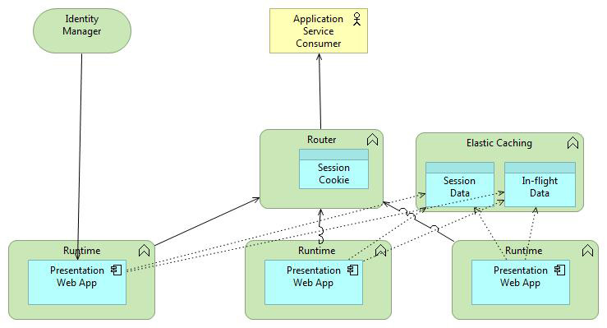
Stateless App Pattern
This Stateless App pattern's objective is to ensure that the system can simultaneously scale to serve a large number of requests and keep the execution path length to a minimum
The basic mechanism used is the CloudOE horizontal scaling capability. Horizontal scaling is provided by the dynamic opening and closing of instances of the execution environment and by a system-level router/balancing component.
To use dynamic scaling efficiently, application components must be completely stateless. Usually in a traditional web application, all requests coming from a certain user are routed to the same application server instance, which keeps the session data and conversation status in memory. A session cookie is used as a key to retrieve session data from memory and handle the request. In cloud computing, most hosting cloud implementations will not guarantee that the same application instance will serve a session. Session requests might be routed to different application instances by the Internet-facing router. Therefore, in this pattern, to keep the execution instances completely stateless, the memory storage used is external and shared as a service among all the instances provided by the hosting cloud. (Otherwise, no scaling down could be possible until all sessions for a certain instance are closed.)

Slide 17
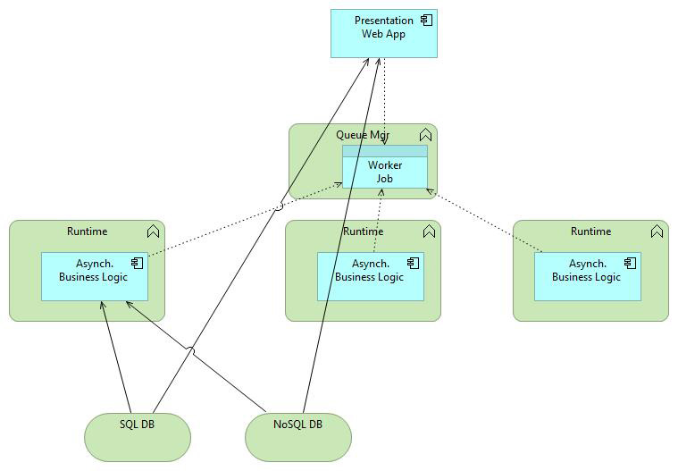
Asynchronous App pattern
The Asynchronous App pattern is used for the event-driven part of the solution and in general when a synchronous response is neither possible nor envisaged
The pattern consists of a pool of stateless asynchronous business services (also known as workers) that take jobs from a queue, execute them, and store the results in a (SQL or NoSQL) database for consumption by one of the other patterns (for instance, the Stateless App pattern). A job is a self-contained set of commands and context with which another pattern communicates with the worker. The jobs are usually put in the queues by a front-end application. The results of processes are stored in a database so that the front-end application avoids scanning queues or waiting for a queue-correlation ID.
Multiple worker types, multiple job types, and multiple queues can all exist, each one with a certain specialization. Therefore, using different queues, the pattern can be used to enforce the correct sequencing of a set of activities. The preferred database is an eventually consistent database that might have a local replica, at least for read operations. SQL databases with a single instance are used only when the ACID (atomicity, consistency, isolation, durability) characteristic is important — for example, for information-transfer operations such as debit-credit operations on bank accounts.

Slide 18
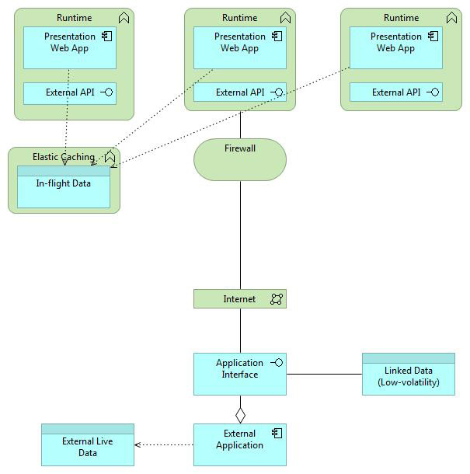
External API pattern
The External API pattern is useful when you must integrate an external (outside of the CloudOE) system — for instance, an IaaS-based application — into your PaaS solution. In this case, you can assume that the external system has a published SLA on which you can generally rely — "generally," because the pattern's exact purpose is to shield your application from any "execution glitch" the external application might have
The pattern is supported by the caching of in-flight data among the instances of the API that serve your (and the other) applications. To take an example from the AMGRO scenario, payment attempts and confirmations received from the external payment service in the last 24 hours can be cached so that there's no need to access the external service if the AMGRO.cloud user requests a list of last payments made.

Slide 19
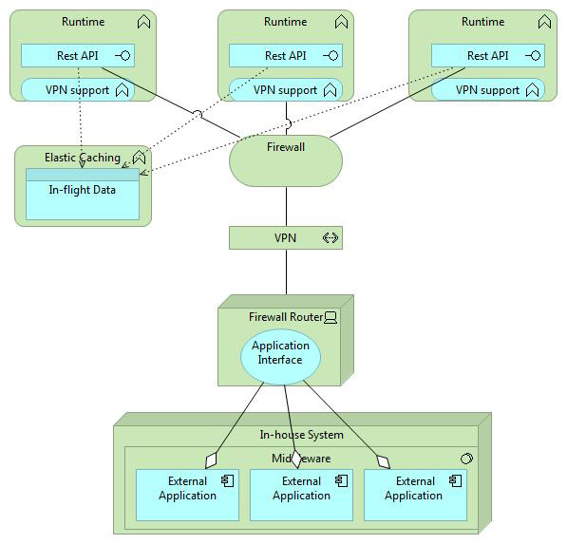
Secure VPN pattern
The Secure VPN pattern is a variation of the External API pattern. The Secure VPN pattern aims to cover the need, typical of hybrid cloud applications, to integrate on-cloud with on-premises components
The assumption behind this pattern is that you can control both environments and therefore govern the cumulative SLAs much better than in the External API pattern.
The on-premises part of the system will rely on traditional architecture patterns such as clustering to ensure scaling and availability (this is true for both bare-metal and IaaS solutions). The only notable add-on on the cloud side is the caching of in-flight data (to reduce communications flowing through the high-overhead VPN channel).
The VPN channel is the heart of the pattern, because it establishes a trusted communication between the two pieces of the application. For this reason, in addition to the standard CloudOE firewall, a software VPN capability, provided as a service by the CloudOE, is used by the PaaS application and corresponds to a similar (hardware or software) capability on the on-premises side.

Slide 20
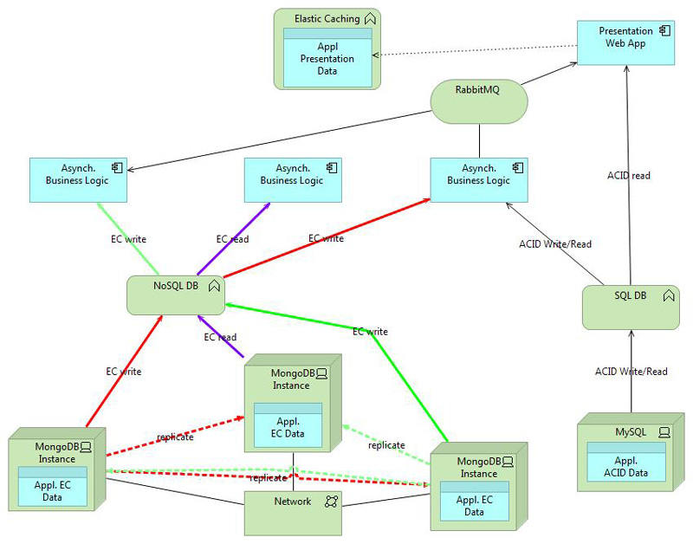
ACID and eventual-consistency database pattern
The fact that a CloudOE offers both SQL ACID database services and No-SQL eventual-consistency database services isn't, strictly speaking, a design pattern. But we include it here because this flexibility is important for the PaaS architect
SQL databases guarantee that operations are performed in a sequential order no matter how many users are using the service. This is enforced through the locking of resources, so that conflicting updates can't happen. A read returns either the last value of a field or the last-but-one (and the desired behavior can usually be customized by the user). On the minus side, the locking mechanism limits either the number of active instances (as multiple any-to-any replicas become rapidly unmanageable) or requires a database with a single central locking table — a single point of failure for the entire system.
A NoSQL database such as MongoDB maintains the same rules for local writes but then replicates those writes over multiple distributed copies. If a copy fails, the others take over its clients. Replication cannot be immediate, so a read operation on one of the copies might return a last-but-nvalue. The copies will eventually be consistent, but we do not know exactly when. Eventual consistency is a powerful scaling mechanism for data with low volatility, because local reads are much faster than remote ones. For instance, results from workers (which are typically written once and never updated) are good candidates to go on an eventually consistent database. By contrast, some if not most high-volatility data requires the ACID properties of an SQL database.

Slide 21
Serverless Functions
Serverless Functions are small, single-purpose functions that are triggered by events without the need to manage a run-time environment.
With Serverless Functions it is possible to build asynchronous event-driven architectures using single-purpose microservices.
The name serverless is a bit misleading because your code runs also on servers, with the key difference that the cloud provider takes care of spinning up instances to run your code and scaling out under load.
Typical use cases for FaaS are use cases that are triggered by an event in the cloud, such as the arrival of an event on a queue, media processing on arrival of a new media file in a storage location, processing log events or executing scheduled tasks.

